Slide 1
E-commerce: A Social Shopping Platform
By
Asmaa Khaled
Amna Abd-El-Razik
Shahd Mohamed
Clara Ayman
Instructor: Eng. Mohamed Ahmed Sayed

Slide 2
Our Agenda
1
Introduction
2
Analysis
We'll begin by introducing the challenges faced in traditional e-commerce, highlighting the need for a more engaging and interactive shopping experience.
We'll discuss the comprehensive market research and competitor analysis that informed our platform's development and design, ensuring its relevance and competitive edge.
3
Technologies
4
Objectives
We'll provide an overview of the technologies powering our platform, emphasizing the robust infrastructure and cutting-edge features that enable seamless user experience.
We'll delve into our overarching goals, outlining how our platform aims to revolutionize e-commerce by fostering social engagement and community building
5
Features
6
Design
We'll showcase the key features of our platform, highlighting how they empower users and businesses to connect, share, and grow within our ecosystem.
We'll delve into the design philosophy behind our platform, focusing on user-friendliness, intuitive navigation, and visually appealing aesthetics that enhance user engagement.
7
Future Enhancements
8
Website Overview
We'll outline our vision for future platform developments, showcasing our commitment to continuous innovation and adapting to evolving user needs.
We'll provide a comprehensive tour of our website, demonstrating its functionalities and showcasing the engaging user experience it offers.

Slide 3
Challenges in E-commerce
Lack of Personalization
Low user engagement
Inefficient Growth Strategies
can result in decreased sales and reduced customer retention. Customers may feel disconnected, leading to a lack of brand loyalty. Businesses risk losing market share to competitors who prioritize social interaction.
E-commerce has transformed how consumers shop, but it often lacks social interaction. This lack of interaction can lead to lower user engagement and customer loyalty. Understanding these challenges is crucial for businesses seeking to enhance their reach and connection with users.
Many businesses struggle to effectively reach and engage new audiences, often relying on limited marketing channels. Our platform empowers businesses to grow their audience organically by providing them with tools to interact directly with potential customers, share their products, and build brand loyalty.

Slide 4




Problem Statement: Key Issues
Lack of social interaction:
Difficulty following favorite products or sellers:
Communication issues:
Small business challenges: Owners struggle to showcase their products and reach a wider audience.
Shopping platforms feel impersonal without social features.
Users find it hard to contact sellers or stay updated on new products.
Users cannot easily keep track of what they like.

Slide 5
Research Objectives
1
User Needs & Preferences
Conducting user research to identify the pain points and aspirations of e-commerce shoppers, understanding their preferences for social interaction, product discovery, and personalized experiences.
2
Market Trends & Competition
Analyzing market trends in e-commerce and social media integration, identifying competitor strategies and identifying opportunities for differentiation and innovation.
3
Technological Advancements
Evaluating emerging technologies relevant to social commerce, including artificial intelligence for personalized recommendations, blockchain for secure transactions, and augmented reality for immersive shopping experiences.

Slide 6

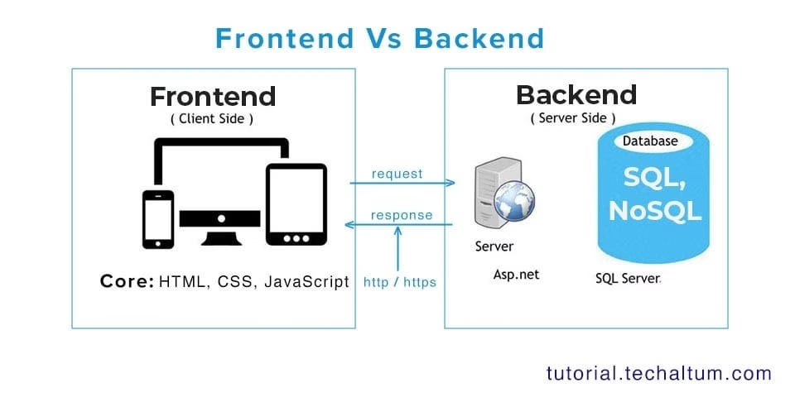
Technologies
HTML
The foundation of our platform's structure and layout, ensuring a clean and responsive web design.
CSS
Responsible for the platform's visual presentation, enhancing user experience with aesthetic appeal and intuitive navigation.
JavaScript
The backbone of our platform's interactivity, enabling dynamic features like user interactions, real-time updates, and engaging animations.
Databases : SQL
Securely storing and managing user data, product information, and transaction history, ensuring data integrity and reliable platform performance.
MVC
Facilitating seamless integration with external services and platforms, extending our platform's functionality and connecting with diverse user needs.

Slide 7
Features
Admin Features
Add , Edit and Delete products
Interactive Product Reviews
Users can share their experiences with products through detailed reviews Admin,Bussinessowner and users
Filtering by Category
Search for Products
Create multiple Accounts
Admin, Business owners and users

Slide 8
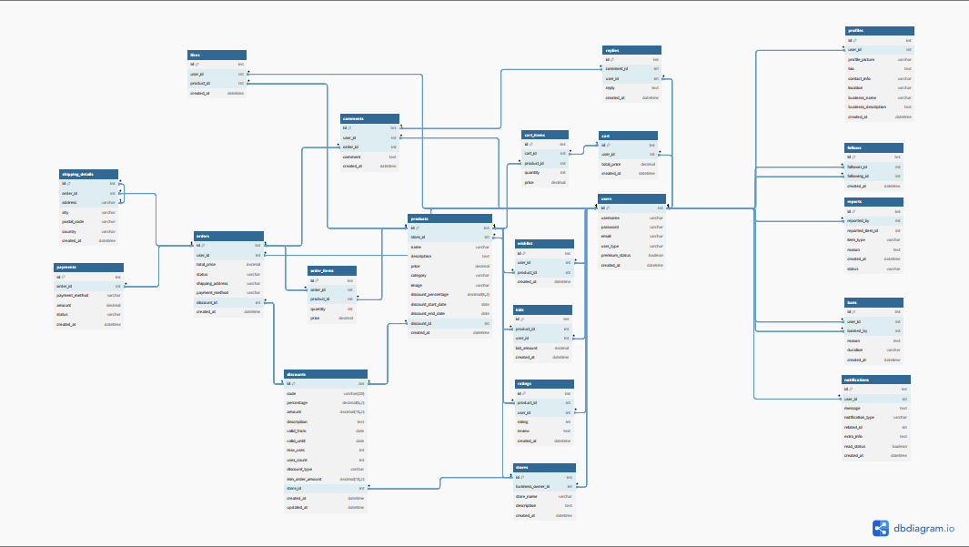
ERD

Slide 9
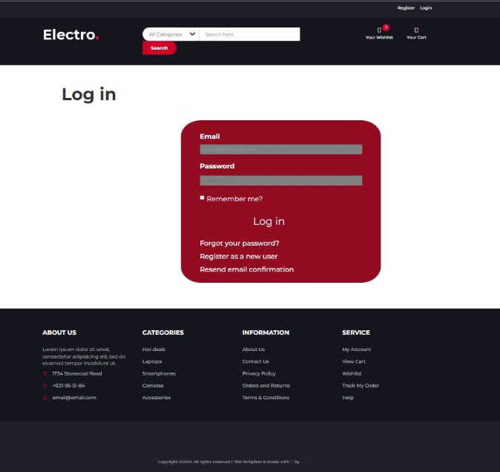
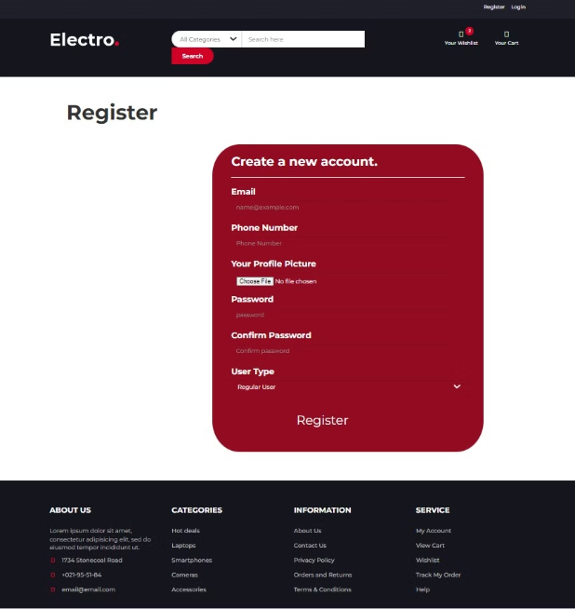
Design

Slide 10
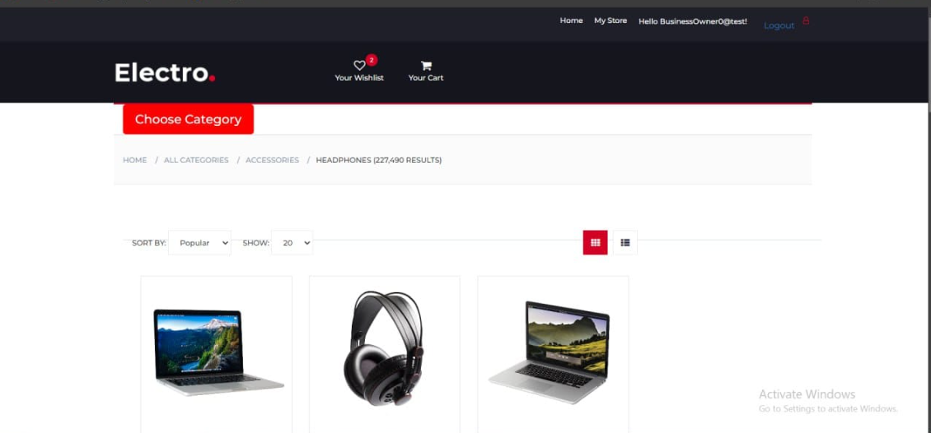
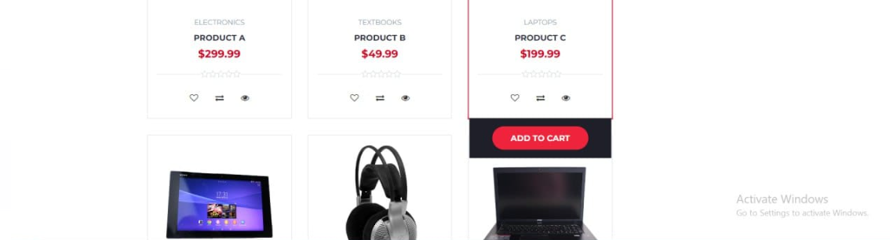

Slide 11
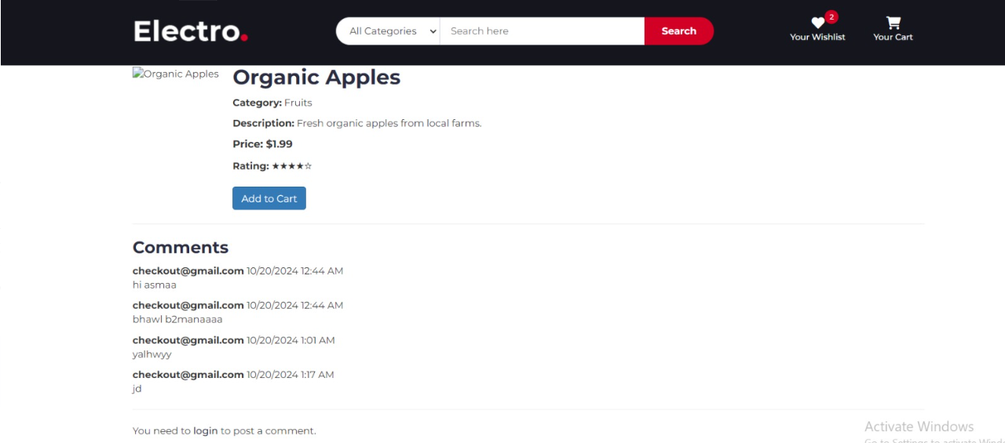

Slide 12
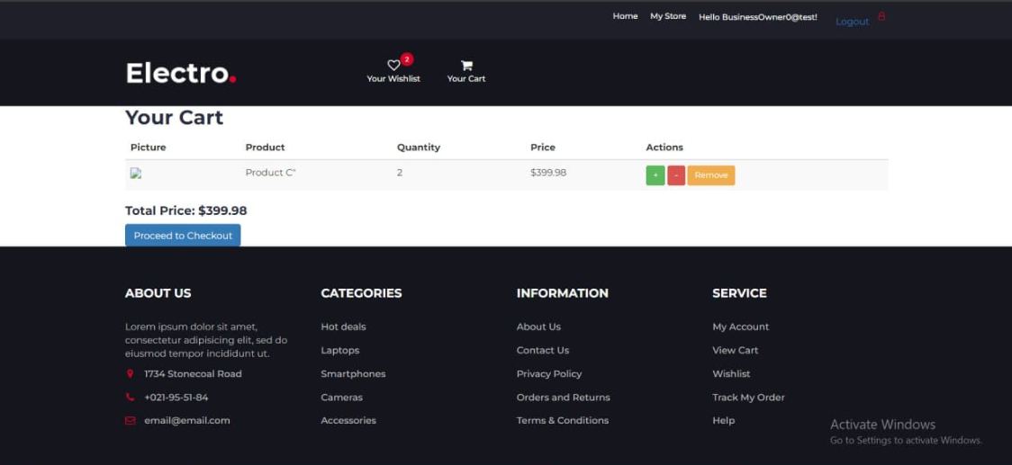

Slide 13
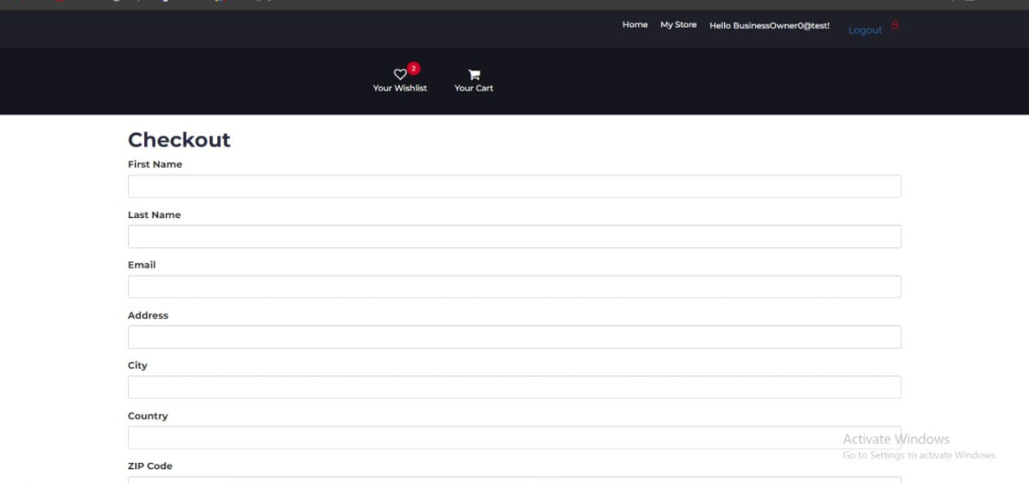
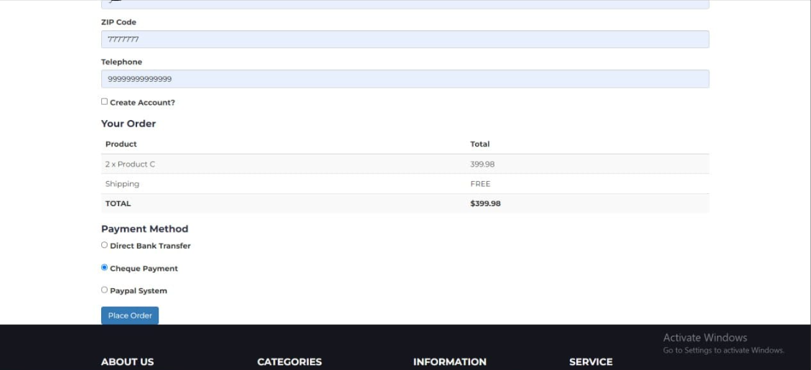

Slide 14
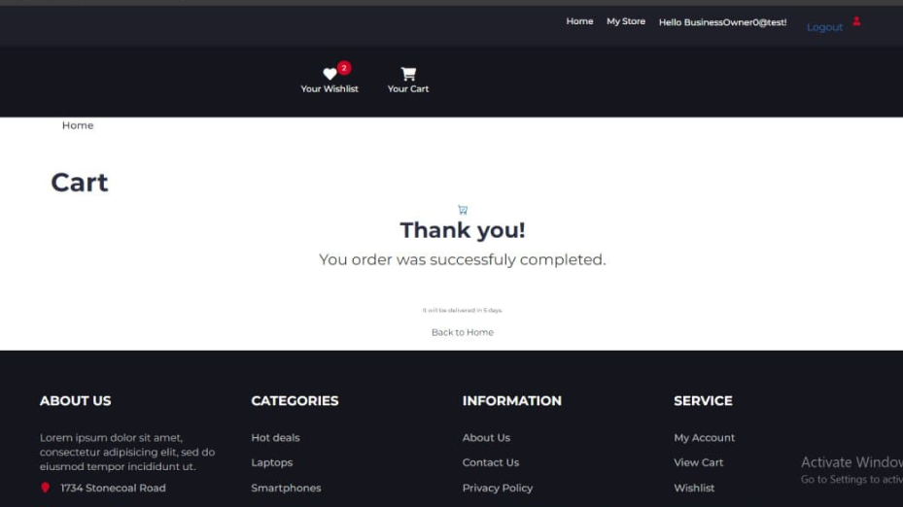

Slide 15
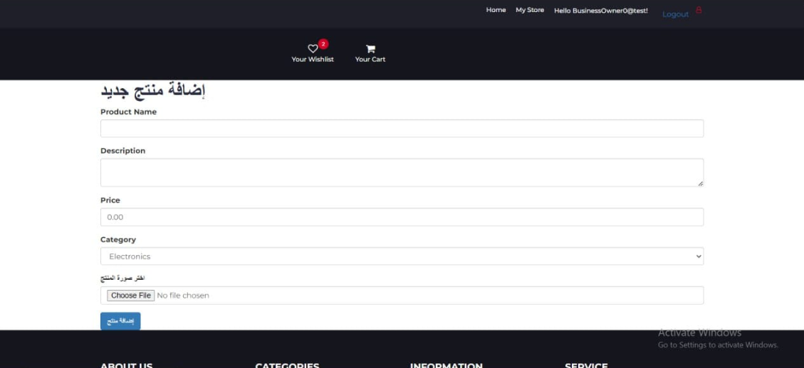

Slide 16
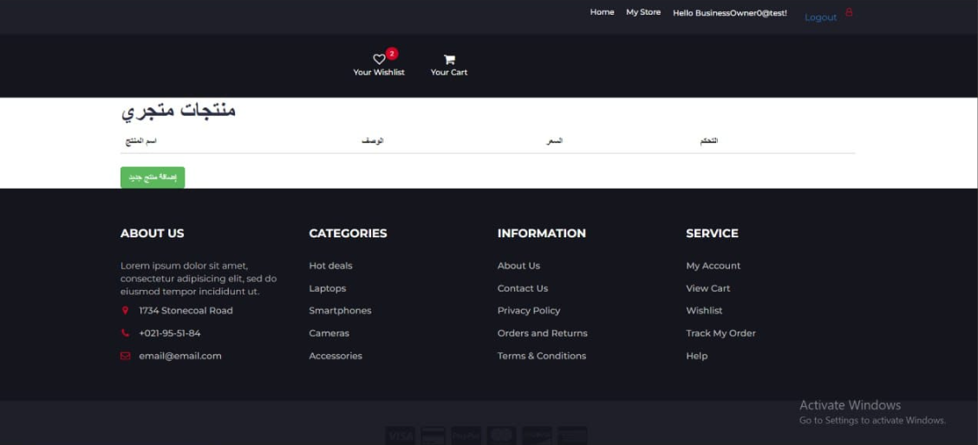

Slide 17




Future Enhancements
Augmented Reality Integration
Live Shopping Events
Enhancing product discovery and visualization with immersive augmented reality experiences, allowing users to virtually try on clothes, view furniture in their homes, and interact with products in a more engaging way.
Facilitating real-time shopping experiences with live streaming features, allowing users to interact with sellers, ask questions, and purchase products directly within the platform.
Blockchain-Based Transactions
Data Analytics
Implementing secure and transparent transaction processes using blockchain technology, ensuring secure payments and enhancing user trust within the platform.
Utilizing analytics to gain insights into user behavior, purchase patterns, and product trends, providing valuable data for businesses to optimize their strategies and personalize their offerings.

Slide 18
Conclusion
Our social shopping platform presents a compelling solution to the challenges faced by traditional e-commerce by fostering community engagement, personalized experiences, and innovative growth strategies. We are confident that our platform will revolutionize the way users shop, interact, and discover new products, creating a vibrant and rewarding online experience for all.

